Slide 1

API Testing

Slide 2

Agenda
Definition
Testing APIs
Automation APIs
Getting Started Workshop
Questions

Slide 3
1
What’s an API?
Notes:
General Template Guidance
Information to help you make good presentations

Slide 4
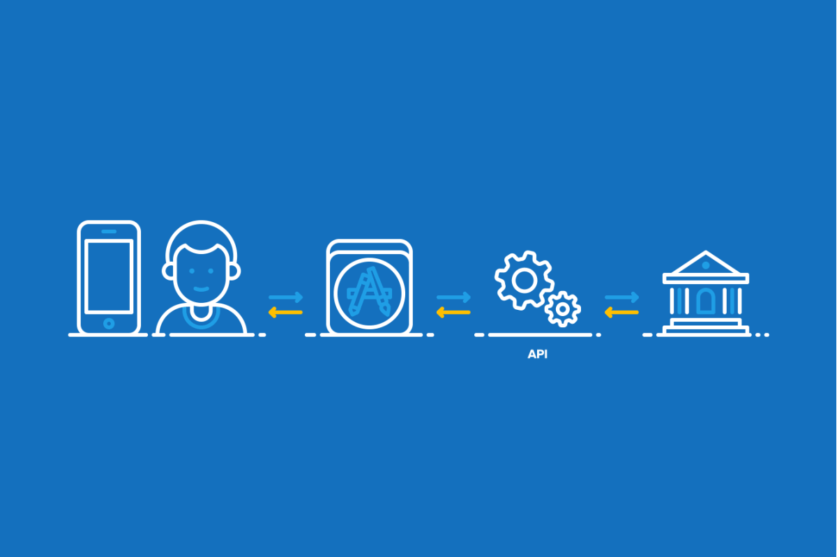
API Testing
Definition:
API is an acronym for Application Programming Interface.
It enables communication and data exchange between two separate software systems. A software system implementing an API contains functions/sub-routines which can be executed by another software system.
A way of accessing the application without using a Web Browser or the Graphical User Interface (GUI).
Interface to an application designed for other computer systems to use.

Slide 5
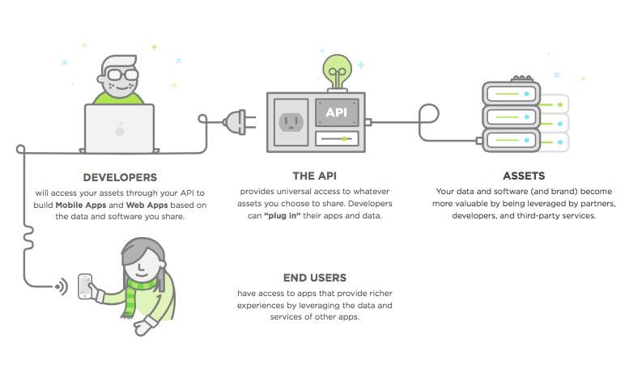
API Testing
How do they work?

Slide 6
API Testing
API Flow

Slide 7
API Testing
SYNC/ASYNC

Slide 8
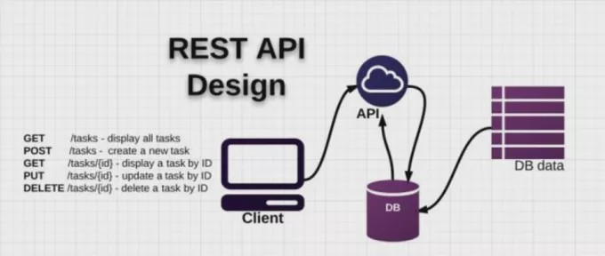
API Testing
REST APIs
REST API = API will respond to HTTP verbs as commands.
What is an HTTP Request?
Hypertext Transfer Protocol -> a way of sending messages to a software on another computer over the internet or over a Network.
HTTP requests consists of:
A verb specifying the type of request: GET, POST, PUT ...
A set of HTTP Headers. The headers specify information such as the type of Browser, type of content in the message and what type of response is accepted in return.
A body or payload in the request representing the information sent to, or from the Web Application.
HTTP Status Codes:
They tell us what happened when the server processed the request.
• 1xx - Informational • 2xx - Success e.g. 200 Success • 3xx - Redirection e.g. 302 Temporary Redirect • 4xx - Client Error e.g. 400 Bad Request, 404 Not Found • 5xx - Server Error e.g. 500 Internal Server Error • 5xx - Server Error e.g. 500 Internal Server Error
Notes:
When we issue REST calls, there are a few HTTP return codes we would expect to see:
200 (OK) when we GET to retrieve information
401 (Unauthorized) when we try to access information without the correct credentials e.g. without logging in
404 (Not Found) when we GET information that does not exist, or POST, PUT DELETE to an end point that does not exist
201 (created) when we use POST to create a new entity
409 (Already Exists) we we try to create an existing entity
302 (Redirect) when we successfully issue a request, the system may redirect us somewhere else, e.g POST a login request and be redirected to the user dashboard

Slide 9

2
Testing APIs

Slide 10
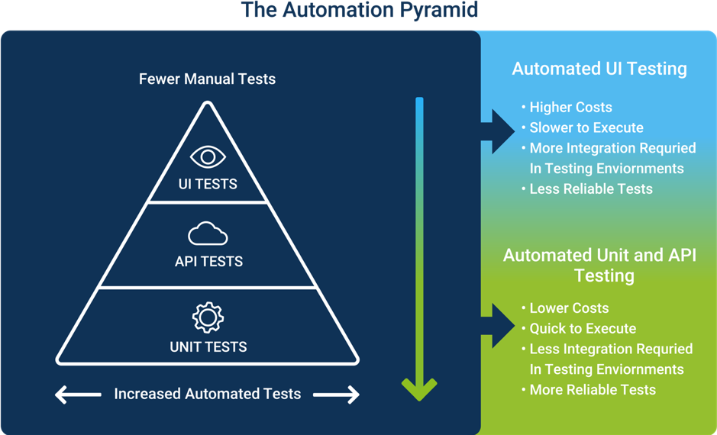
API Testing
Why to test the API?
API Tests allow the tester to verify the functionality of the code without using the UI. At the service layer we aim to test web services, integration of functions or integration with other systems.
They are quicker to create and to execute than UI tests.
The higher the level, the slower, more difficult to maintain and more brittle.
With tests in the API layer we can test inputs and outputs of the API. It allows testers to test boundary conditions, edge cases, error conditions
“We want to do as little as possible UI tests” Mike Cohn

Slide 11

API Testing
Test Cases:
Test cases for testing an API are based on:
Return values based on input conditions: it is relatively easy to test, as input can be defined and results can be authenticated
No return value: When there is no return value, behavior of the API on the system has to be checked
Triggering some other API/event/interrupt: If output of an API triggers some event or interrupt, then those events and interrupt listeners should be tracked
Updating data structure: Updating data structure will have some outcome or effect on the system, and that should be authenticated
Modifying resources: If the API call modifies some resources then it should be validated by accessing the respective resources

Slide 12





API Testing
Approach
Explore the API
Understanding the functionality of the API
Have a clear scope
Clearly define the scope of the application
Apply best practices of testing
Apply testing techniques such as equivalence classes, boundary value analysis and error guessing, and write test cases for the API
Pay attention to parameters
Input Parameters for the API need to be planned and defined appropriately
Execution
Execute the test cases and compare expected and actual results.

Slide 13
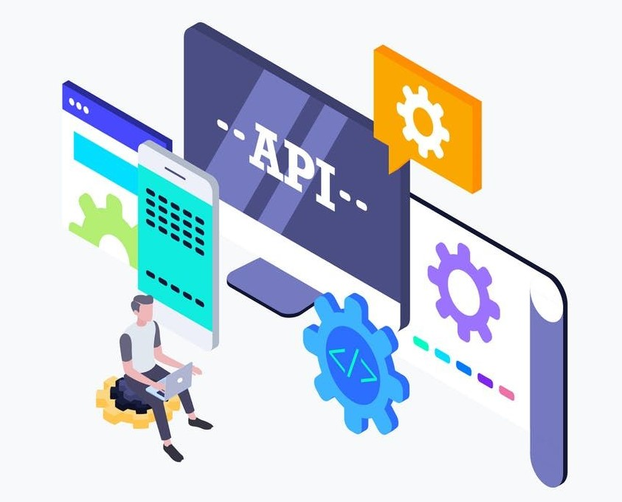
API Testing
POISED test Strategy
Parameters — the range of parameters passed to the API
Outputs — validating proper outputs for both good and bad parameters
Interoperability — Ensuring consistency with other service APIs and other calls
Security — Ensuring access and authorization maintained for API calls
Errors — Report errors clearly and accurately
Data — Handle data structures and real data properly and with the appropriate timing

Slide 14
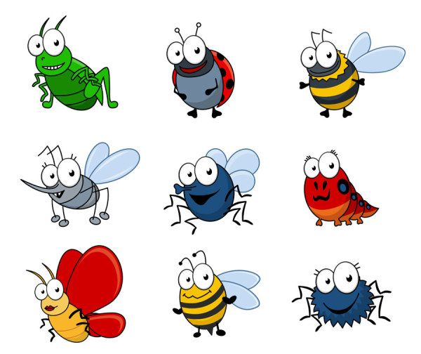
API Testing
Types of Bugs:
Fails to handle error conditions gracefully
Unused flags
Missing or duplicate functionality
Reliability issues. Difficulty in connecting and getting a response from API.
Security Issues
Multi-threading issues
Performance Issues. API response time is very high.
Improper errors/warnings to caller
Incorrect handling of valid argument values
Response Data is not structured correctly (JSON or XML)

Slide 15



Notes:
Logo Usage
This slide provides different versions of our logo to use in your presentations.

Slide 16


API Testing
Environment Set-up
API Testing is different than other testing types as GUI is not available, and yet you are required to setup an initial environment that invokes the API with a required set of parameters and then finally examine the test result.
Hence, setting up a testing environment for API testing seems a little complex.
Database and server should be configured as per the application requirements.
Once the installation is done, API Function should be called to check whether that API is working or not.
We will need to execute the HTTP calls and read through the responses.
Notes:
Standard text slide (version 2)
Use standard text slides as little as possible. They can be used for an introduction to a presentation, summary of work, detailed legal information.
All presentations should be a mix of text-heavy pages and visual pages.
In a presentation, choose between 1, 2, or 3 column text pages to be consistent within the document.
Use the text-heavy part of the page to relate to the data in the right column of the page.

Slide 17
3
What do we need?
Automating APIs

Slide 18





Slide 19

API Testing
Rest Assured is a Java DSL (domain specific language) that allows you to write powerful readable and maintainable tests.
REST Assured is Java DSL for simplifying testing of REST based services”.
A library, with a fluent interface, for automating REST services and HTTP applications easily.
Options for Rest assured: unirest.io, resty, jersey, Apache HttpClient
http://rest-assured.io
Support for HTTP methods (GET,POST, PUT, ...)
Support for BDD / Gherkin (Given, When, Then)
Use of hamcrest matchers for checks (equalTo)
Use of Jsonpath/GPath for selecting elements from JSON response.

Slide 20

API Testing
JUnit 5 = JUnit Platform + JUnit Jupiter + JUnit Vintage
The JUnit Platform serves as a foundation for launching testing frameworks on the JVM. It also defines the TestEngine API for developing a testing framework that runs on the platform. Furthermore, the platform provides a Console Launcher to launch the platform from the command line.
JUnit Jupiter is the combination of the new programming model and extension model for writing tests and extensions in JUnit 5. The Jupiter sub-project provides a TestEngine for running Jupiter based tests on the platform.
JUnit Vintage provides a TestEngine for running JUnit 3 and JUnit 4 based tests on the platform.
You can also use TestNG

Slide 21

Getting Started

Slide 22
API Testing
Study Case
https://restful-booker.herokuapp.com/
https://restful-booker.herokuapp.com/apidoc/index.html
Repo of the workshop
https://github.com/SantiagoCabrales29/API-Testing-Workshop-2021.git

Slide 23

API Testing
Git Flow:
feature/1-Getting-Started
feature/2-RequestSpecification
feature/3-Environment-Variables
feature/4-Separating-Logics
feature/5-Introduction-to-Abstractions
feature/6-Serialization-and-Deserialization
feature/7-Adding-More-Tests
feature/8-Gherkin-and-Clossure

Slide 24

API Testing
Advices:
Some things that I’ve learned
UNDERSTAND WHAT YOU ARE DOING
Es importante poder justificar lo que se hizo en cierto paso. Si uds no entienden su código quien lo va a entender?
SEPARATE TEST CODE FROM LOGIC
Es recomendable tener una estructura de Proyecto definida y que sea practico y fácil de entender.
USE ABSTRACTIONS
Las abstracciones nos permiten ver el código de una manera mas entendible
USE PATTERS
Es importante utilizar estándares y patrones de diseño que nos faciliten la implementación de nuestras pruebas.
DO NOT REINVENT THE WHEEL
Usa lo que ya esta creado, no vale la pena ponerse a inventar algo que ya existe.
USE WHATEVER FITS YOU
Usa lo que conoces y en lo que te sientas cómodo.
SPEAK!
Comunicarse con el equipo puede traer beneficios a la hora de crear nuestra suite.
FOLLOW CLEAN CODE
Re usar clases, métodos cortos, nombres dicientes, etc.

Slide 25
API Testing
Define the feature files with all your stakeholders using Behavior-Driven Development (BDD). Automatically create documentation that’s up to date and easily shareable.
Tools & techniques that elevate teams to greatness
A Step Definition is a Java method with an expression that links it to one or more Gherkin steps. When Cucumber executes a Gherkin step in a scenario, it will look for a matching step definition to execute.
https://cucumber.io/docs/cucumber

Slide 26
API Testing
Other important info and documents
Rest Assured: http://rest-assured.io
https://github.com/rest-assured/rest-assured/wiki/Usage
Bas Dijkstra Rest Assured Workshop: https://github.com/basdijkstra/rest-assured-workshop
Rest Assured TA University Course: https://testautomationu.applitools.com/automating-your-api-tests-with-rest-assured/
Hamcrest Matchers: http://hamcrest.org/JavaHamcrest/javadoc/1.3/org/hamcrest/Matchers.html
Gson: https://github.com/google/gson

Slide 27

Challenge:
Now it’s your turn:
https://developers.themoviedb.org/3/getting-started/introduction.
https://www.themoviedb.org/
The mandatory features to cover with the automated tests are
Authentication
Lists
Rate of movies
Rate of tv shows
Rate of tv episodes
Must include at least three get, three post and three delete. (There’s no put)
Due date:

Slide 28
Other Tools not covered in this workshop

Slide 29



Slide 30
Internship - Api Testing
CICD

Slide 31
Questions?

Slide 32
THANK YOU!
Santiago CABRALES
Santiago.CABRALES@ENDAVA.COM

